Slide 1

Eklavya E-Learning Platform
Group No 9
Ashish Dhanorkar 230943020015
Sushant Manjare 230943020053
Mayur Pawar 230943020055
Pranav Nerkar 230943020071
Vijay Zite 230943020113

Slide 2
Problem Statement
In rural India, the lack of accessible and inclusive education remains a significant obstacle to socio-economic progress. Despite efforts to improve literacy rates, numerous challenges persist. Firstly, many rural areas lack adequate educational infrastructure, including schools and trained teachers, leading to limited access to quality learning resources. Additionally, socio-economic factors such as poverty and cultural barriers contribute to high dropout rates and low literacy levels. Furthermore, the digital divide exacerbates these challenges, with limited internet connectivity and technological resources hindering the adoption of e-learning platforms. Language barriers further complicate matters, as many rural communities primarily communicate in regional languages, necessitating localized educational content. Moreover, there's a pressing need for skill development opportunities tailored to local employment needs, as traditional education often fails to address these requirements effectively.

Slide 3
Introduction
Eklavya, our E-learning web application, provides a complete solution for staying updated on emerging technologies. With roles for admin, students, and tutors, it ensures easy access to trending technology knowledge. Users can create accounts, enroll in courses, and tutors can upload course data and track statistics, including profits. The system enables admin oversight of student and tutor records, ensuring quality content and enhancing the learning experience for all users.

Slide 4
Roles And Use Cases
Roles
Instructor
Student
Admin

Slide 5
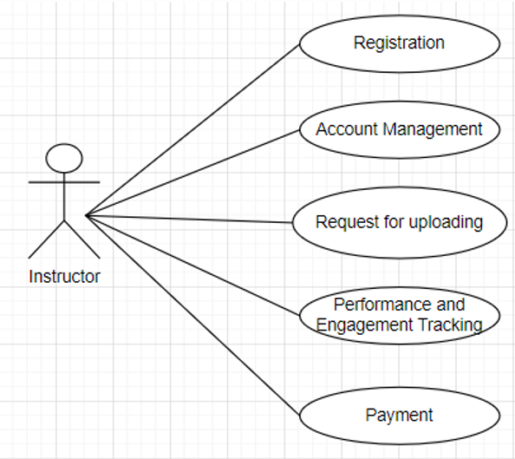
Use Cases - Instructor

Slide 6
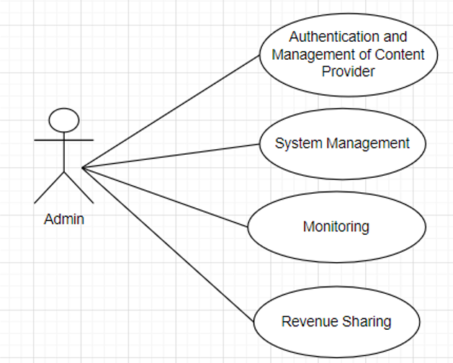
Use Cases - Admin

Slide 7
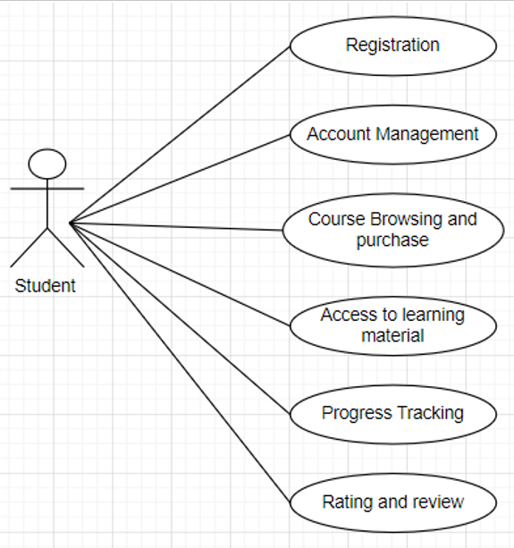
Use Cases - Student

Slide 8
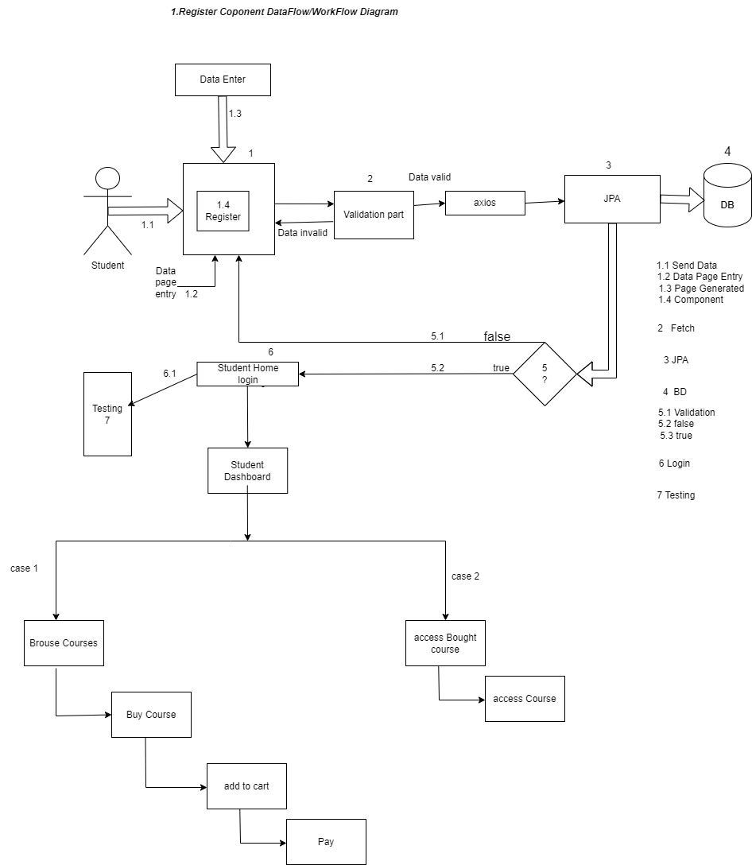
Data Flow Diagram Student

Slide 9
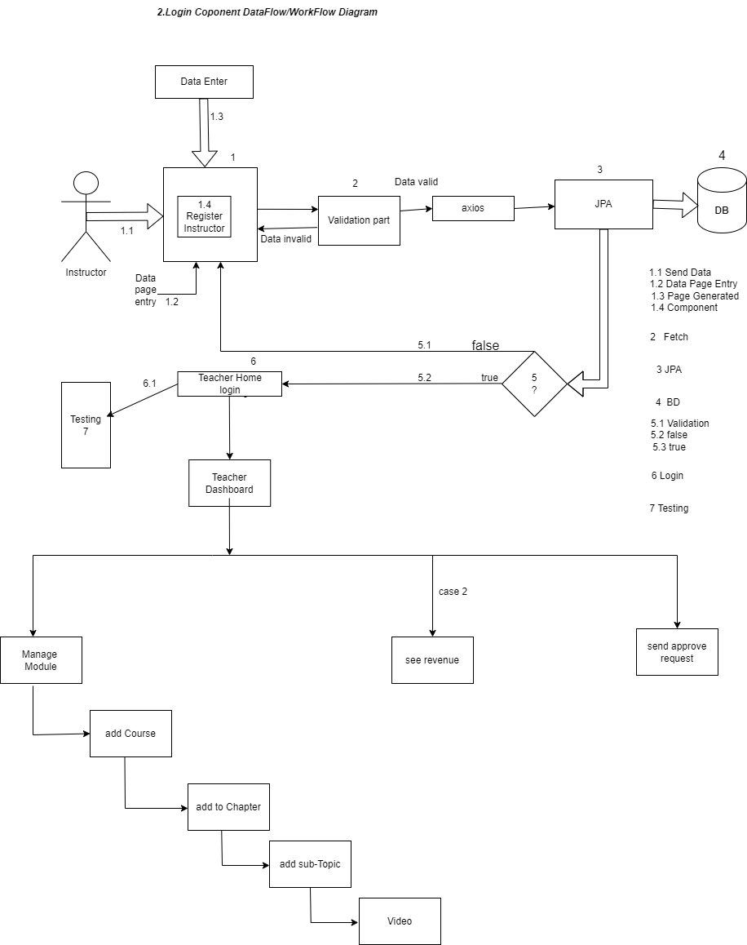
Data Flow Diagram of Instructor

Slide 10
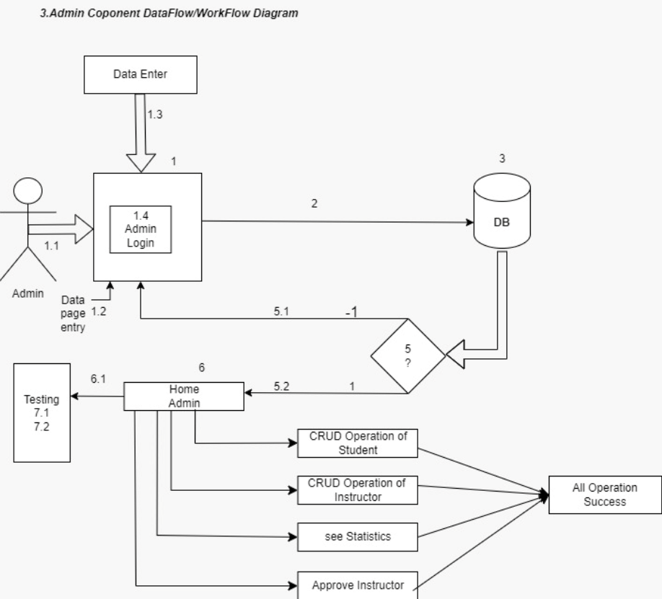
Data Flow Diagram of Admin

Slide 11
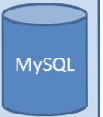
3 Tier Architecture
Client Side
Middle tier with Microservices Architecture
DB Tier
.NET Rest API Server for User
Management Apl’s on localhost:7123
Entity Framework
Web server running on localhost:3000
•
•
•
Using HTML, CSS Bootstrap
React JS components
Spring Boot Rest API Server for Business API’s
on localhost:9090
Running on 3306
JP A
Hiberante
JDBC

Slide 12
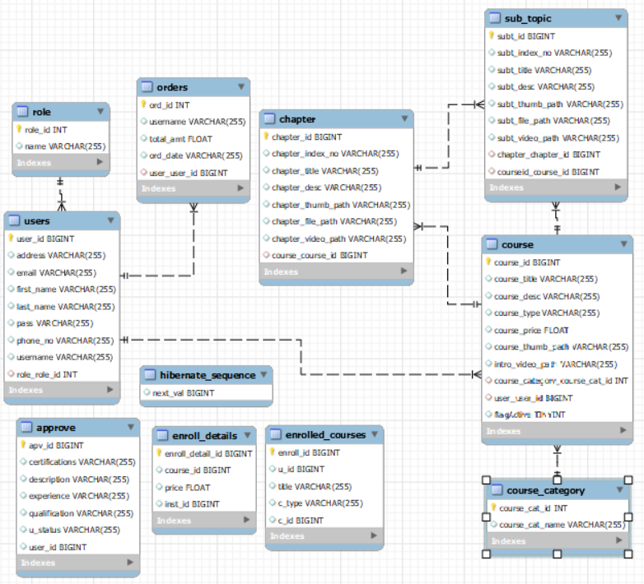
ER Diagram

Slide 13
Project Phases
We have divided our project majorly in three phases:-
Phase 1:
In this phase we planned on creating roles required for the project. We have three roles
Instructor
Student
Admin
We also focused on UI part in this phase. We structured our project by making templates of Frontend, Middle Tier and Backend. Frontend part consists of HTML, BootStrap and React JS components.

Slide 14
Phase 2:
In this phase we added functionalities to our roles using Spring Boot REST API and .NET REST API for our middle tier, React JS for Front End and MySQL for database. We implemented CRUD operations on it Example: Admin has the authority to manage Instructors.
Instructor can create course and Student can see Uploaded Courses.
Phase 3:
In this phase we have implemented functionalities to Upload Video And payment form and admin can do CRUD Operations.

Slide 15
Conclusion
In summary, Eklavya E-learning web application is a tool for staying updated in the rapidly evolving tech world. It offers easy access to the latest knowledge for users, serving as an upscaling platform that virtualizes learning and enables continuous skill development.

Slide 16
Thanks!

